Slide 1
Welcome to the world of HHR Digital Media Presentation.

Slide 2
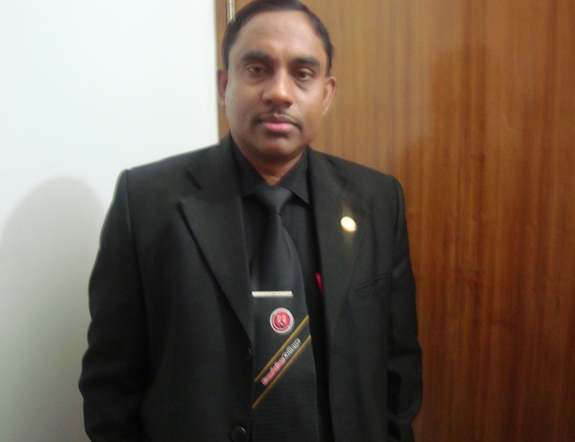
Conducted by-
Md Hasan Hafizur Rahman
Lecturer, English
Cambrian School & College, Campus-05, Dhaka.
Class-9
English First Paper
Writing Part

Slide 3
Let us follow

Slide 4
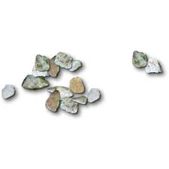

Slide 5
Our today’s lesson is
a story and it is on-
A Thirsty crow

Slide 6
Learning outcomes
After we have studied this lesson we will be able to-
listen information
ask and answer questions
write a story.

Slide 7
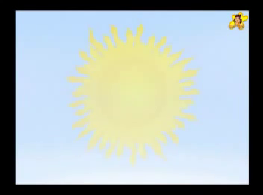
It was a hot summer day.

Slide 8
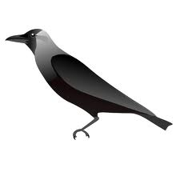
Once a crow was very thirsty.

Slide 9
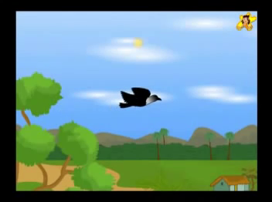
It flew about here and there looking for water.

Slide 10
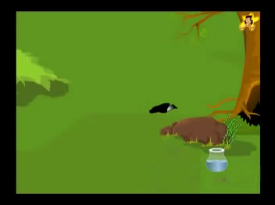
The crow saw a pot of water.

Slide 11
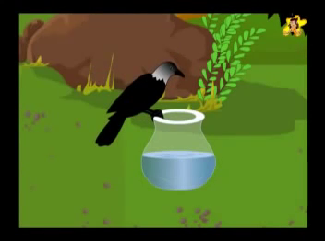
He went close to the pot.

Slide 12
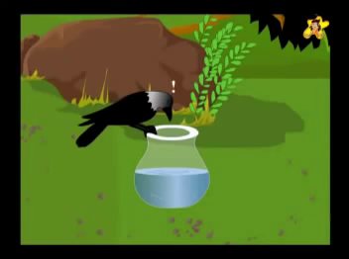
He saw that there was a very little water in the pot.

Slide 13
He could not reach the water.

Slide 14
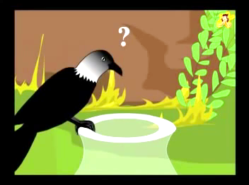
“What can I do? I am very thirsty.” said the crow itself.

Slide 15
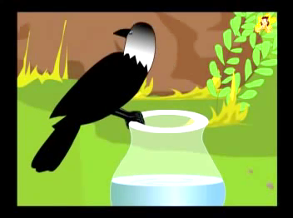
He looked around.

Slide 16
He saw some pebbles.

Slide 17
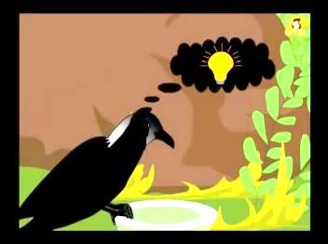
He had an idea.

Slide 18
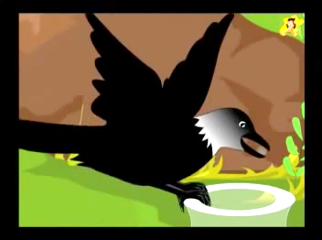
He picked up the pebbles one by one and dropped into the water.

Slide 19
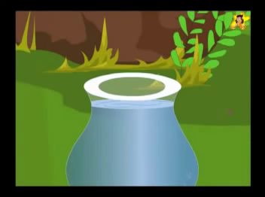
After a while the water came up.

Slide 20
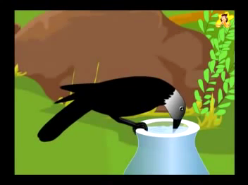
He drank the water.

Slide 21
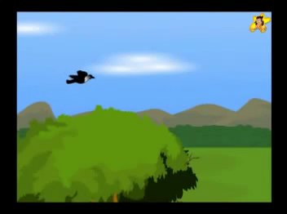
He flew away happily.

Slide 22
Let us enjoy a video

Slide 23
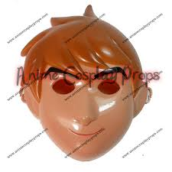
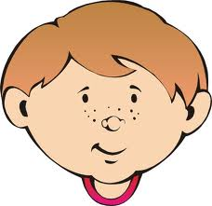
Group Work

Slide 24
Evaluation
Answer the following questions
What is the story about?
Why was the crow flying here and there?
What did he find?
Why couldn’t it reach to the water?
How did he meet up his thirst?

Slide 25
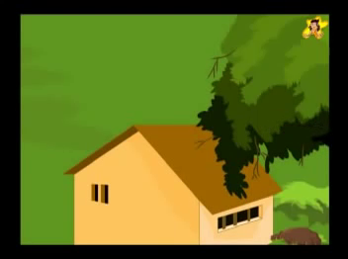
Home work
Write a story on
“A Thirst Crow”

Slide 26
Universal
“Where there is a will there is a way”

Slide 27
Thank You

